Slide 1
Introduction to Phonics and Early Reading
(@ St Michael’s Church School )
Tuesday 14th October
Mrs Dibden & Mr owen

Slide 2
What is phonics
Phonics is a way of teaching children how to read and write.
It is making connections between the sounds of our spoken words and the letters that are used to write them down.
Children are also taught the correspondence between sounds and the way they are written (spelling)
Phonics is currently the main way in which children in British primary schools are taught to read in their earliest years. Research shows it is the most effective way to learn reading and writing.

Slide 3

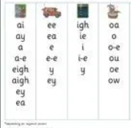
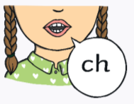
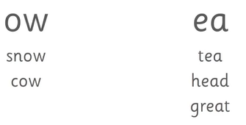
Did you know
The English language has:-
26 letters
44 sounds
Over 100 different ways to spell those sounds
and many more ways to read/pronounce certain letters/groups of letters
It is one of the most complex languages to learn to read and spell!!!!!

Slide 4

Phonics at St Michael’s
Little Wandle
Why Little Wandle?
Excellent training for all staff to ensure consistency
Very detailed, thorough and systematic approach to every aspect of phonics and reading
Engaging resources without distracting from the learning
Comprehensive system for identifying and supporting children, requiring extra help
Useful support for parents
https://www.littlewandlelettersandsounds.org.uk/
Notes:
Explain moved to a new scheme this year

Slide 5
Phonics Lessons @ St Michael’s
Daily lessons for EYFS & Year 1 (and currently Year 2)
Whole Class teaching
Follow a specific order of teaching
4 new sounds per week (review on a Friday)
Use Little Wandle resources-consistent across all classes
Daily assessment of learning and half termly summative assesments
Repeated practice daily
Keep-Up support for those who may need a little extra input

Slide 6
Terminolgy
You may hear your children say…
Phoneme - the smallest unit of sounds.
Grapheme- The written representation of a phoneme (sound). There can be more than one way to spell some phonemes E.g - phoneme ‘ay’ is spelt differently in each of the words ‘way’, ‘make’, ‘fail’, ‘great’, ‘sleigh’ and ‘lady’.
Digraph - A grapheme containing two letters that makes just one sound (phoneme) – oi/ar.
Trigraphs – A grapheme containing three letters that makes just one sound (phoneme) - igh/air
Split digraphs – 2 vowels with a consonant in between - like/cake - (Used to be known as the magic e!)
Adjacent Consonants – 2 consonants sat together that do not make a digraph as you can hear each unit of sound. - stop/first
Blending - Putting together the sounds in a word in order to read it, e.g. ‘f – r – o – g, frog’
Segmenting – Breaking a word into sounds in order to spell them, e.g. ‘frog, f – r – o – g’’

Slide 7
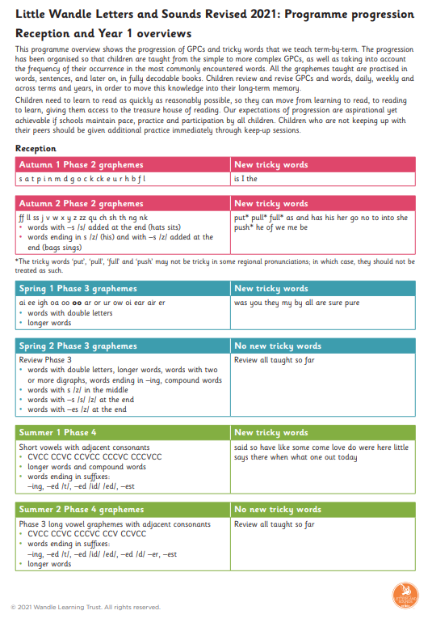
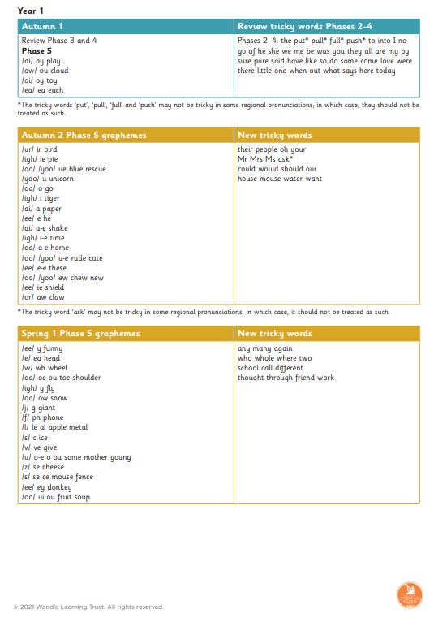
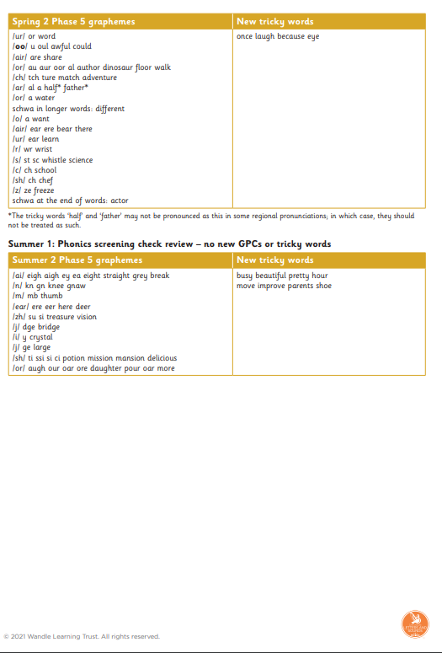
Programme Progression
Show document
https://www.littlewandlelettersandsounds.org.uk/wp-content/uploads/2021/12/Programme-Overview_Reception-and-Year-1-1.pdf

Slide 8
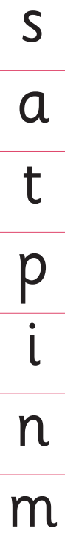
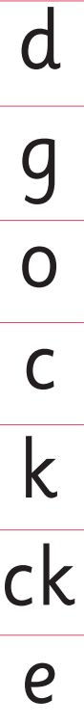
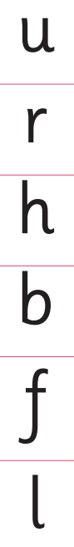
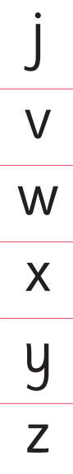
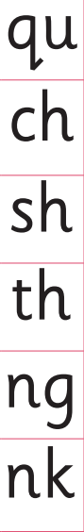
Phase 2
EYFS Autumn 1 and 2

Slide 9
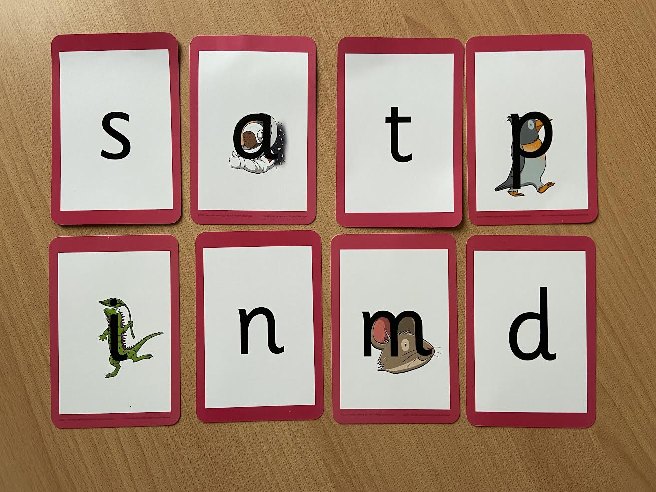
Notes:
Phonemes taught in order start to read words asap
LW has a picture pneumonic to help children remember the phoneme/grapheme

Slide 10
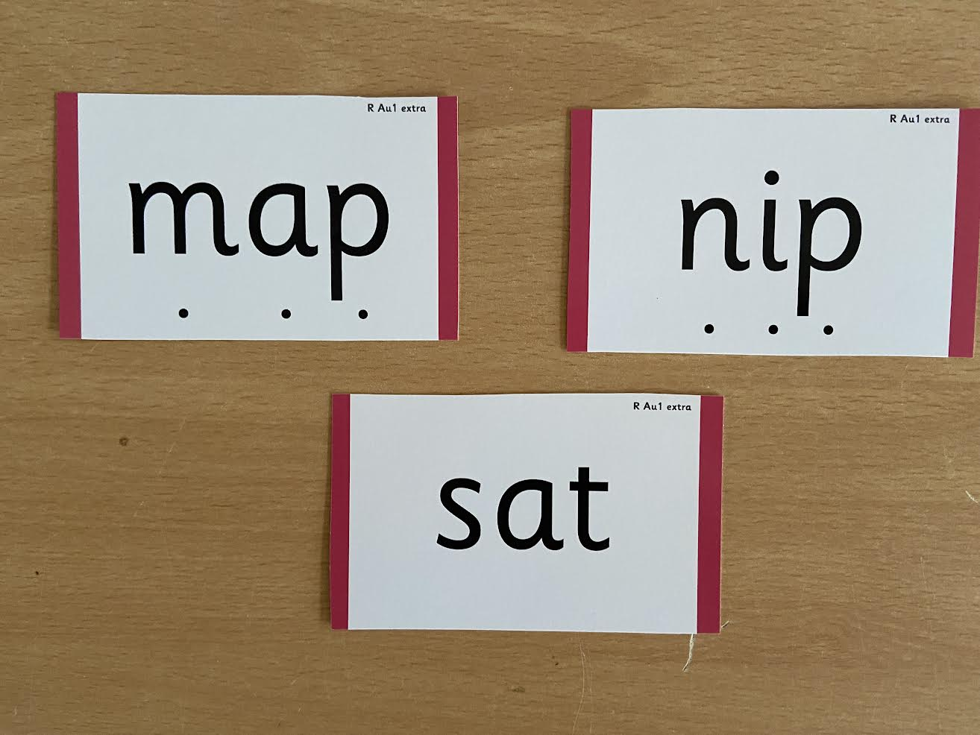
Notes:
During phonics lessons we use Sound buttons so we can sound talk and blend to read

Slide 11
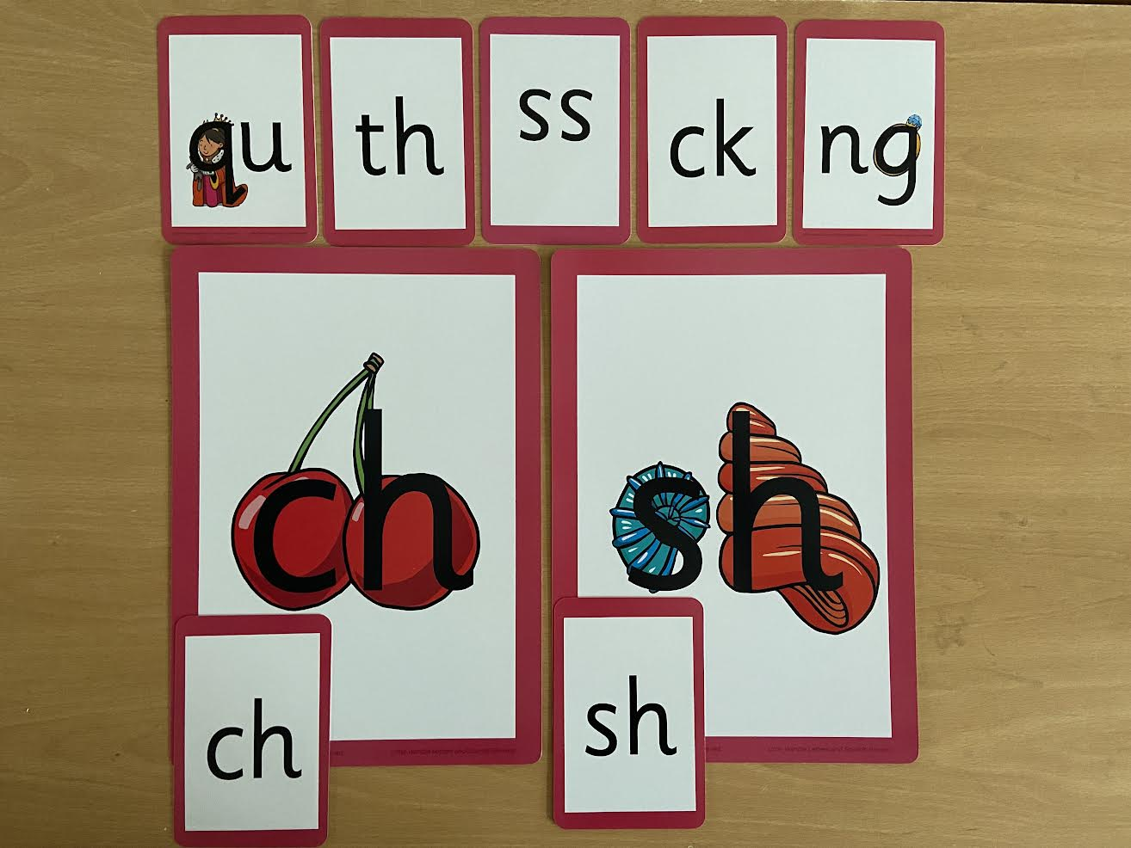
Notes:
Early digraphs mostly consonant digraphs – 2 letters 1 sound

Slide 12
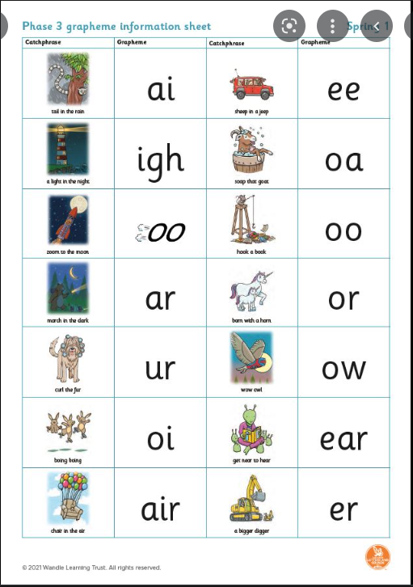
Phase 3

Slide 13
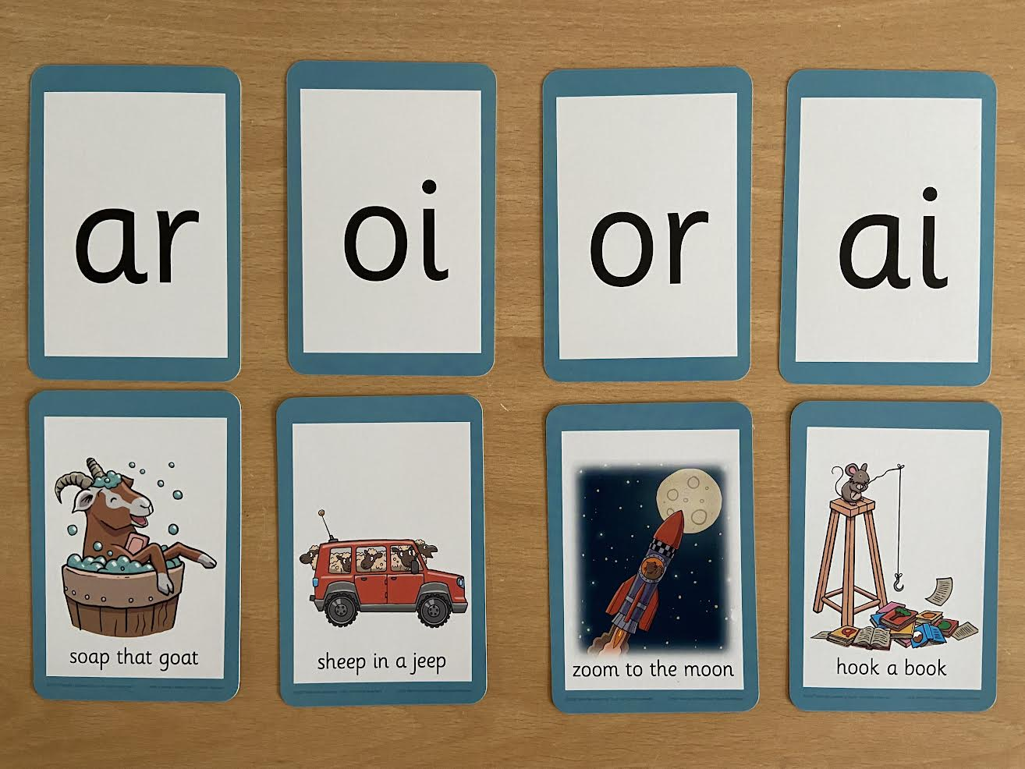
Notes:
Vowel digraphs taught with a short caption to help children remember
Also trigraphs igh, air

Slide 14
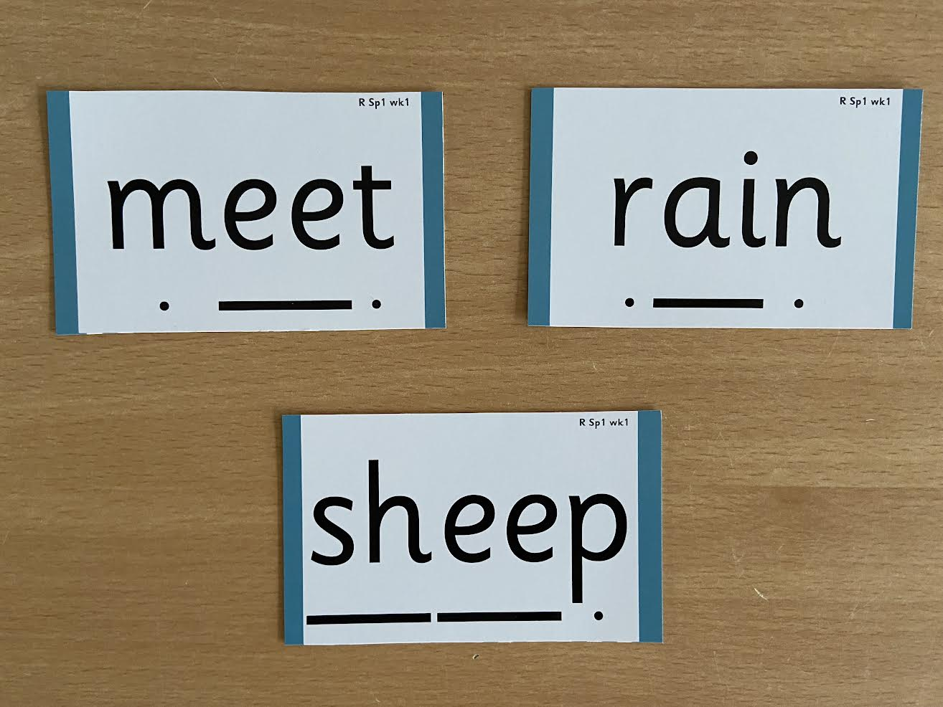
Phase 2
Notes:
Digraphs have a dash to sound talk and blend

Slide 15
Phase 4
In Phase 4, grapheme-phoneme correspondence is not taught.
Instead the children are taught to blend longer words which contain adjacent consonants.
Went fact bring munch
stamp sprint forest shampoo
smashed melted strongest blossom

Slide 16
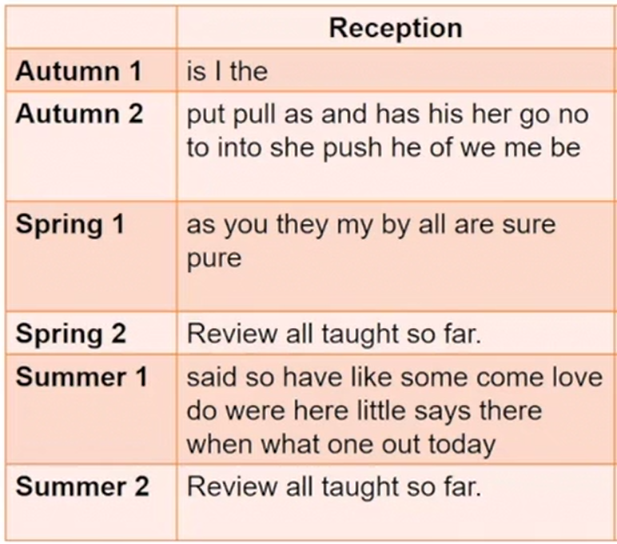
Tricky Words
Notes:
As part of being able to read and spell accurately, need to recognise that some words cannot use phonics for.

Slide 17
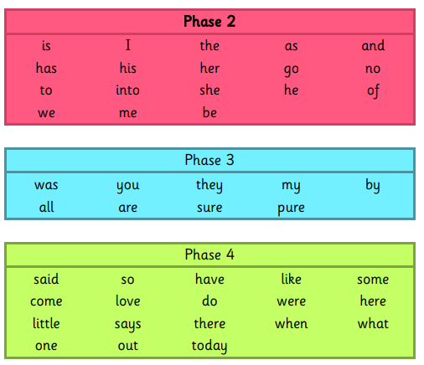
Tricky Words
Notes:
As part of being able to read and spell accurately, need to recognise that some words cannot use phonics for.

Slide 18
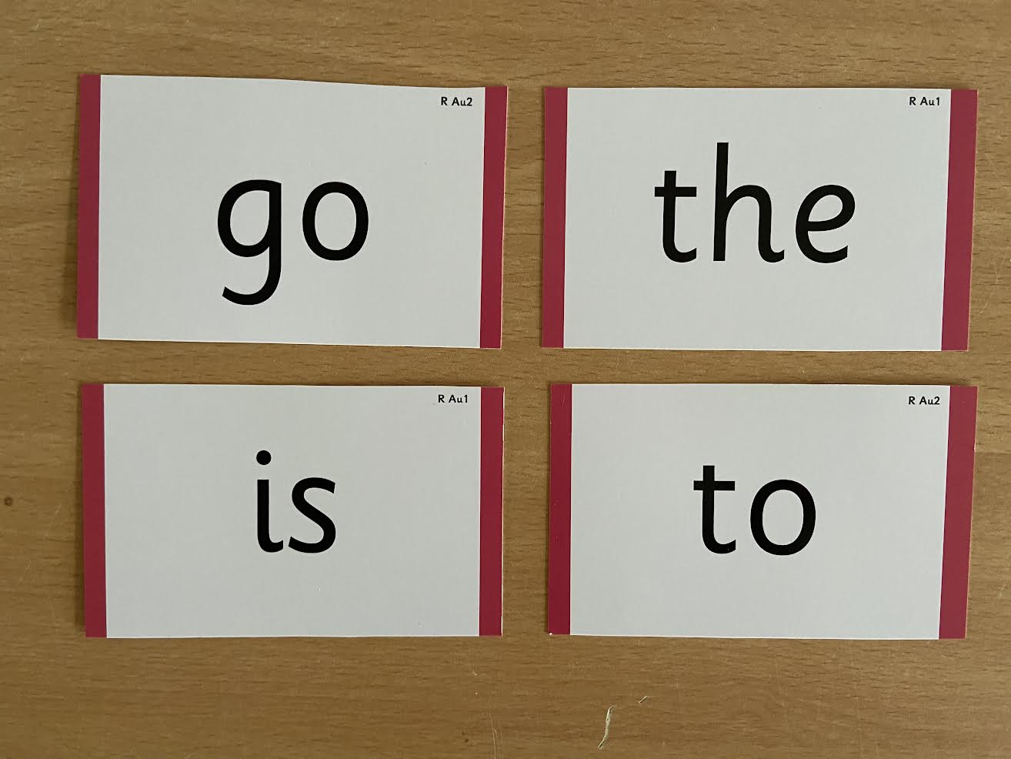
Tricky Words
Notes:
Words that do not follow the rules and cannot be decoded – tricky words/ exception words
Chn are taught what part of the word is tricky

Slide 19
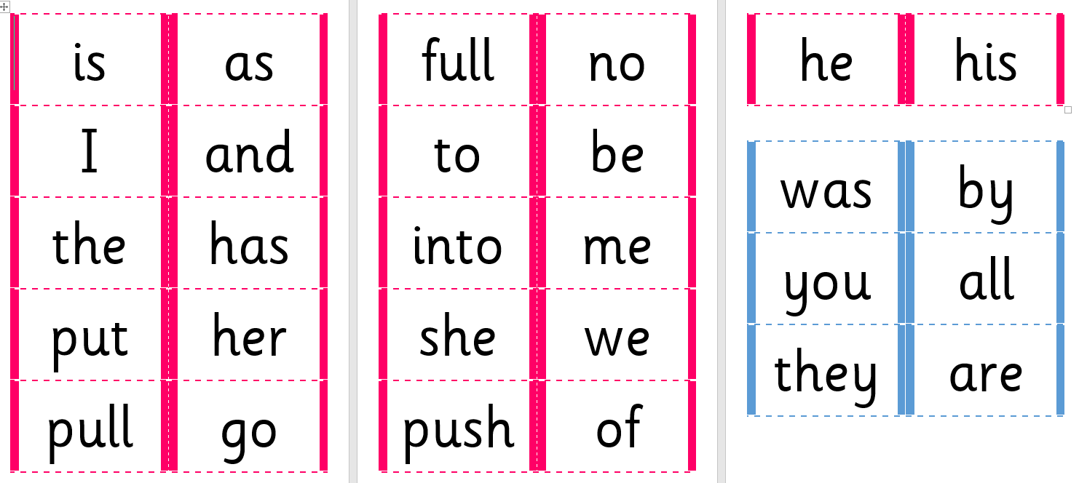
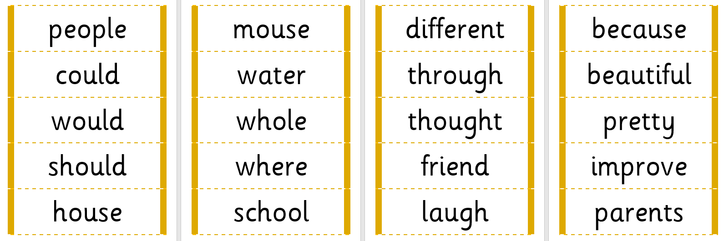
Tricky words @ home
An area to support your child with
Relevant phase to your child’s year group will come home in their new ‘Home Phonics Folder’
Keep them in folder or cut up and use as
flashcards/as part of games around the house.
If you would like another copy,
please speak to class teacher or email us.

Slide 20
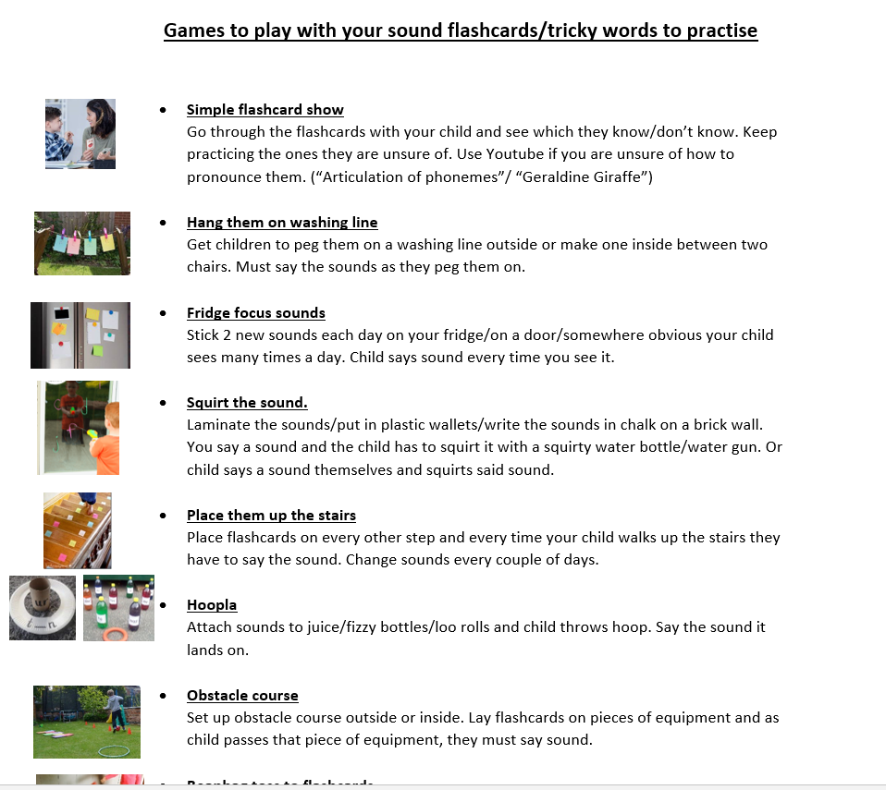
Tricky words @ home
Help learn them through GAMES!!!!

Slide 21
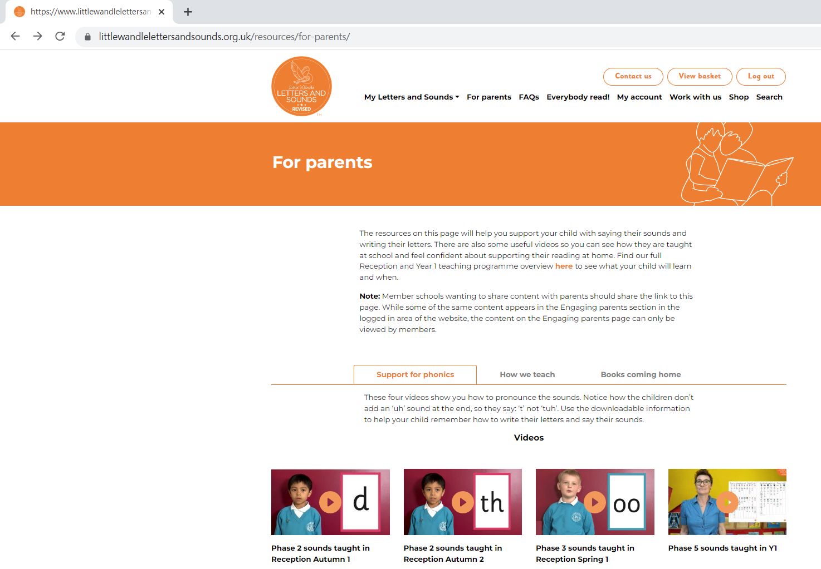
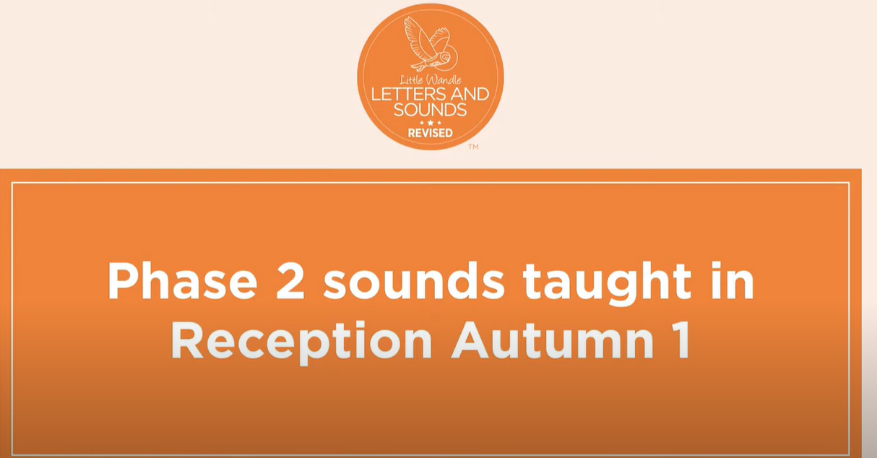
Pronunciation
https://www.littlewandlelettersandsounds.org.uk/resources/for-parents/
https://www.youtube.com/watch?v=-ZtjFIvA_fs

Slide 22
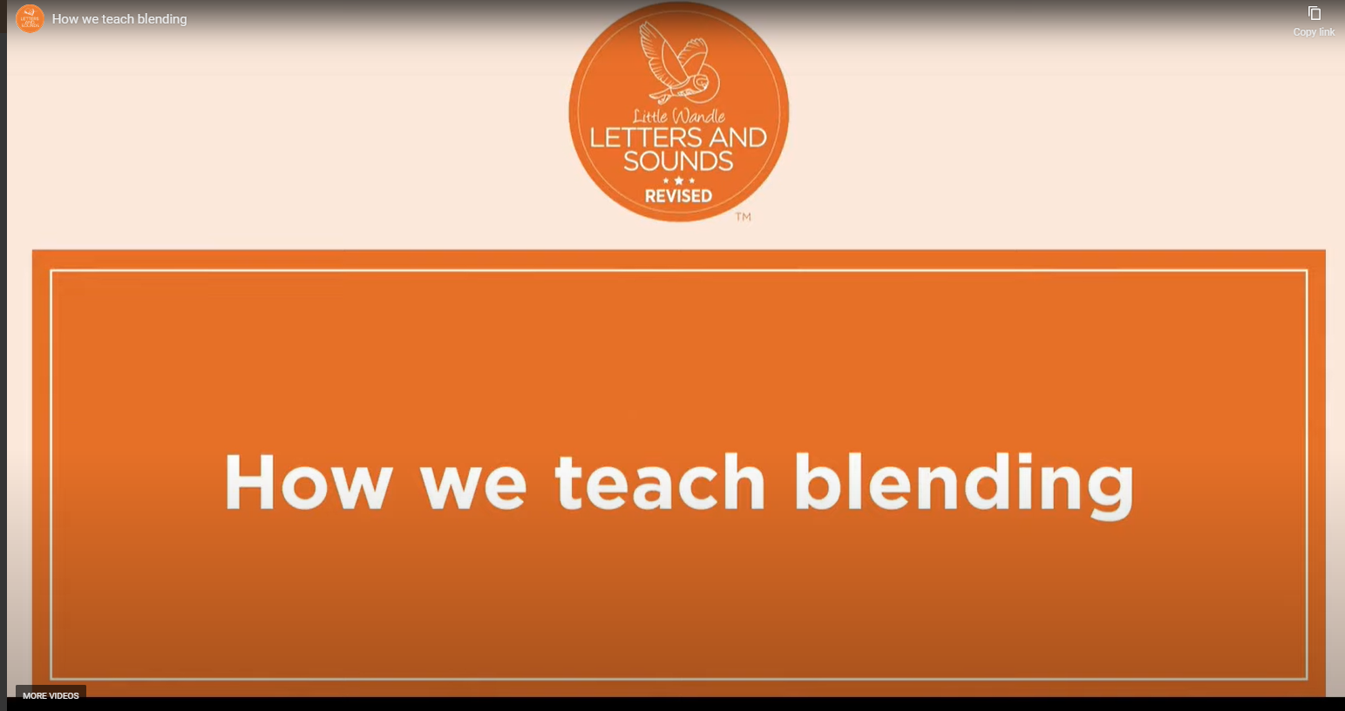
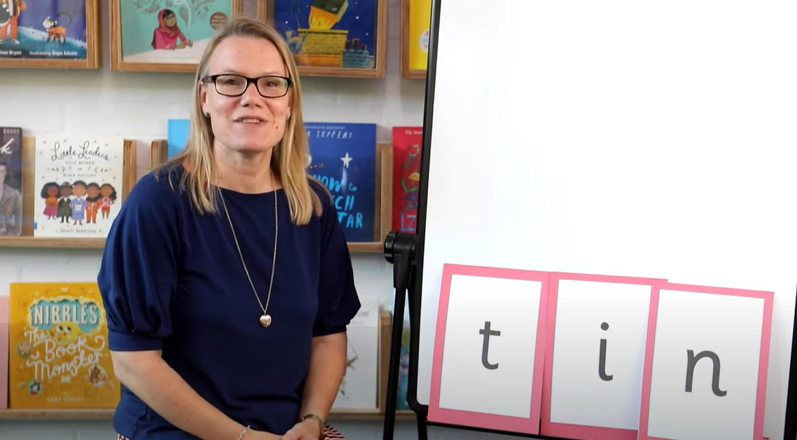
Blending
https://www.youtube.com/watch?v=IL5YUCPyC5I&t=5s
https://www.littlewandlelettersandsounds.
org.uk/resources/for-parents/

Slide 23
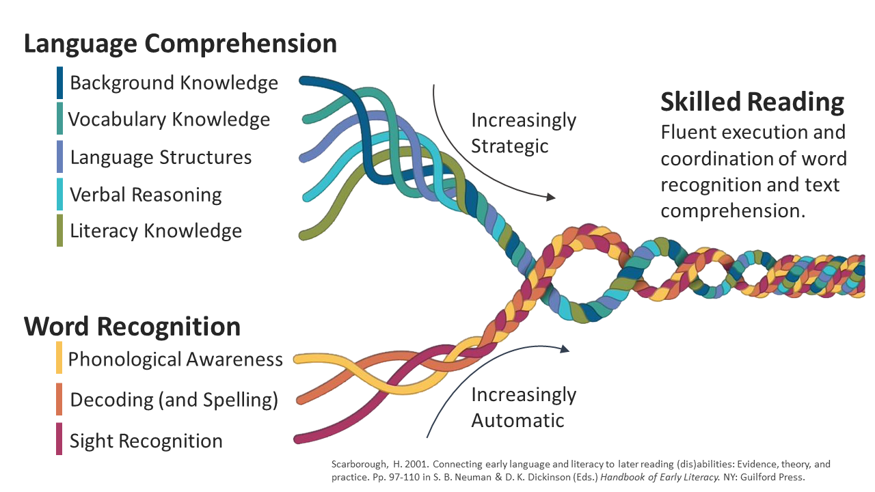

Phonics into Reading
Being a reader is more than just decoding the words...
…but decoding is the very start!!
Learning to read should be a positive experience and enjoyable.
We want children to love reading and to read for pleasure.
We want to encourage life long readers.
Ultimately, reading underpins children’s access to the curriculum
and impacts on outcomes in life!

Slide 24
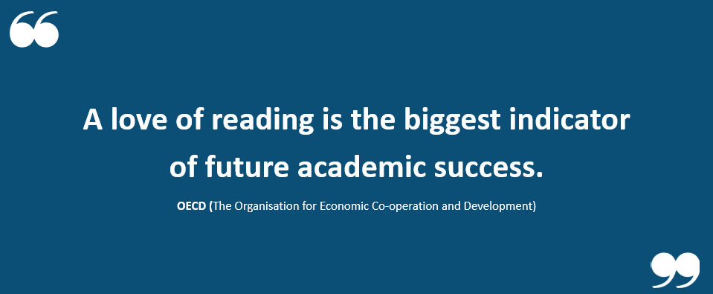

Slide 25

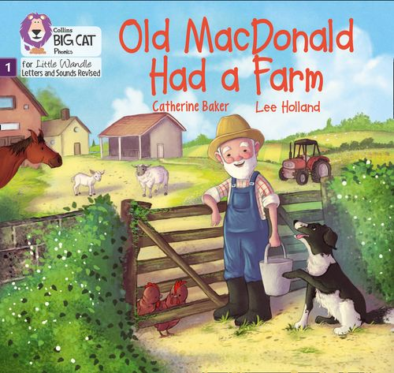

Reading Practice
3 times per week
Taught by trained teacher or teaching assistant
Small groups
Books matched to children’s secure phonic knowledge and word reading so can read them fluently and independently
Before confident in blending =wordless books
This still develops great language and book skills and allows them
to embed oral blending and early reading skills.

Slide 26

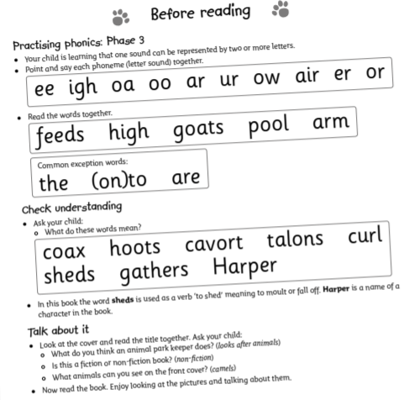
Reading Practice
Reading Practice Books carefully matched (based on Little Wandle Assessments) so children can read fluently and independently
3 Reads – each one begins with some quick sounds and words practice
Decoding
Prosody (intonation, expression)
Comprehension
This book will then be made available as a book for children to read at home.
When children read their book at home, they should be 95% fluent.
Please do not worry that a book is too easy – your child needs to develop fluency and confidence in reading.
Re-reading a book they have had before helps develop fluency – this is the goal.
The more they see the words, the more they begin to read them automatically without having to sound them out.
Celebrate their success!!!

Slide 27
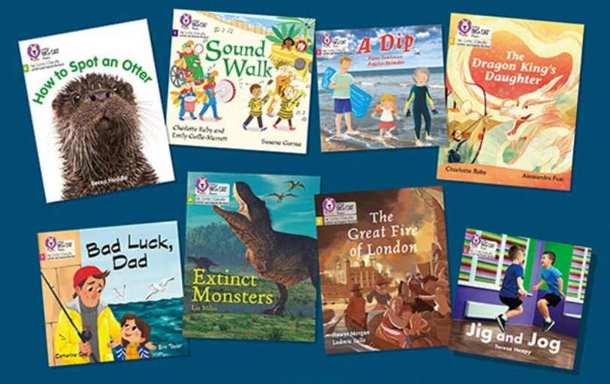
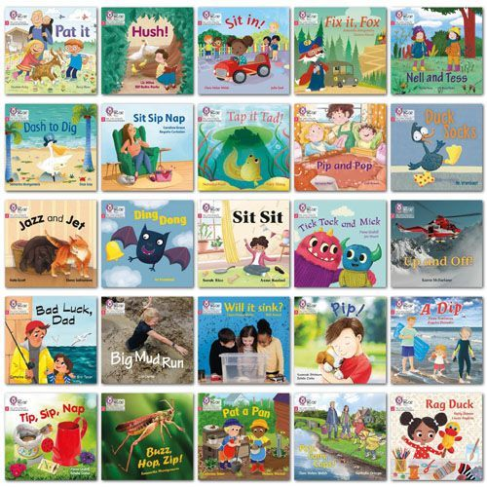


Books to come home
2 books
Reading Practice Decodable Book (Little Wandle Scheme book)
Fully decodable (appropriate and matched to your child’s phonic ability)
Will have read this during the week in reading practice sessions
Children should be fluent and independent in their reading of this book
Reading for Pleasure Book
Selected during their class trip to the school library
Share with your child and enjoy together
Notes:
Please remember that you shouldn’t expect your child to read this alone. Read it to or with them. Discuss the pictures, enjoy the story, predict what might happen next, use different voices for the characters, explore the facts in a non-fiction book. The main thing is that you have fun

Slide 28
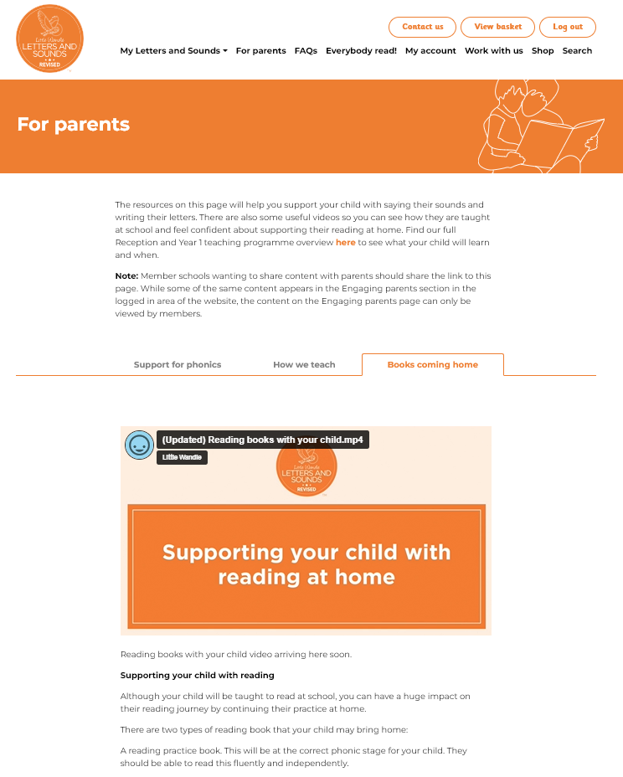
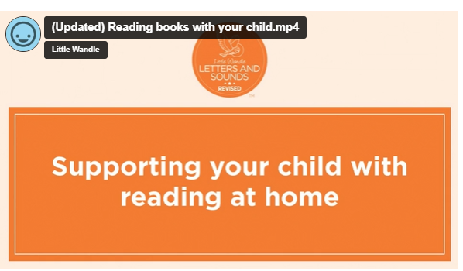
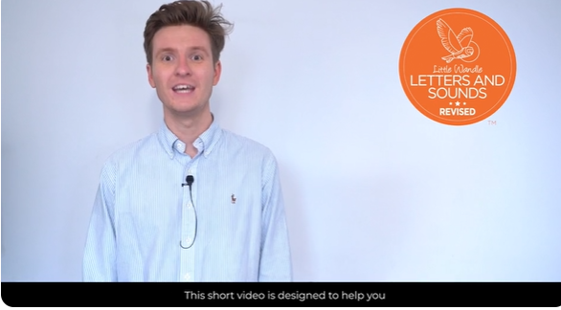
Books to come home
https://www.littlewandlelettersandsounds.org.uk/resources/for-parents/

Slide 29
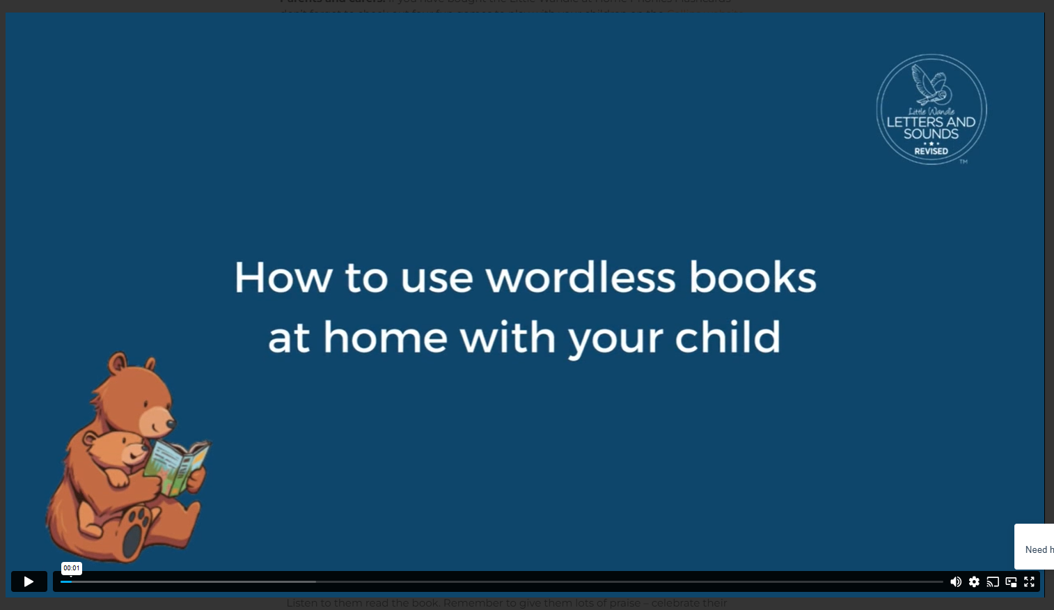
Wordless Books
https://www.littlewandlelettersandsounds.org.uk/resources/for-parents/#tabnametabBooksComingHome (1 min 24 sec)
Reading a wordless picture book
parent guide

Slide 30
Reading with your child @ home
They should be confident with this book. They should be able to read it with 90% accuracy (we have done the teaching work at school)!
Go over the phonemes in the front of the book (if any on display)
Encourage your child to blend the sounds to read the word
(they can blend out loud if they need to but encourage to then blend in their head)
Re-read the sentence after they’ve decoded the words to improve fluency
Model reading a sentence or phrase with expression
Ask them questions as you go and/or at the end.

Slide 31
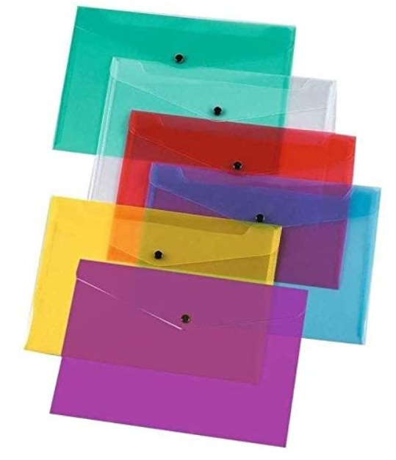
Reading Folders & Diaries
Reading Folder=coloured plastic folder
Contains:
Decodable Book
Reading for Pleasure (library book)
Reading diary
Bring it in daily, make sure it is there FRIDAY please.
Record ANY reading in the diary. Reading Diary –EXPECTATIONS is reading 5x per week.
New Reading Practice book will be changed 1x per week.
Re-reading a book they have had before helps develop fluency – this is the goal

Slide 32
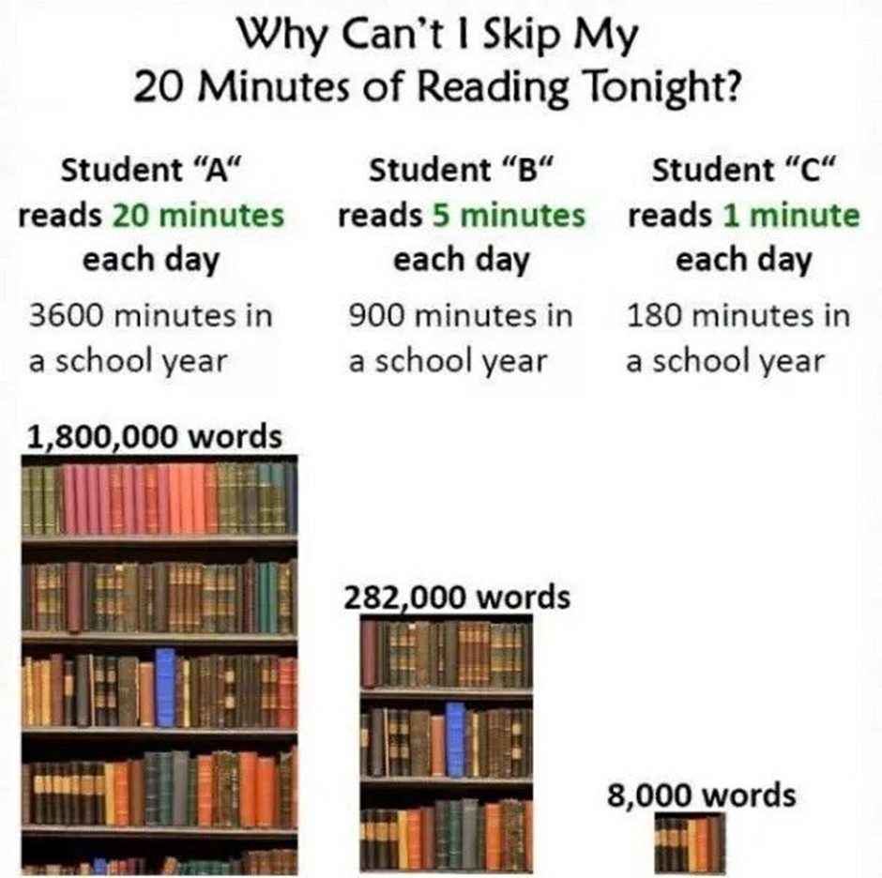
Reading at home

Slide 33
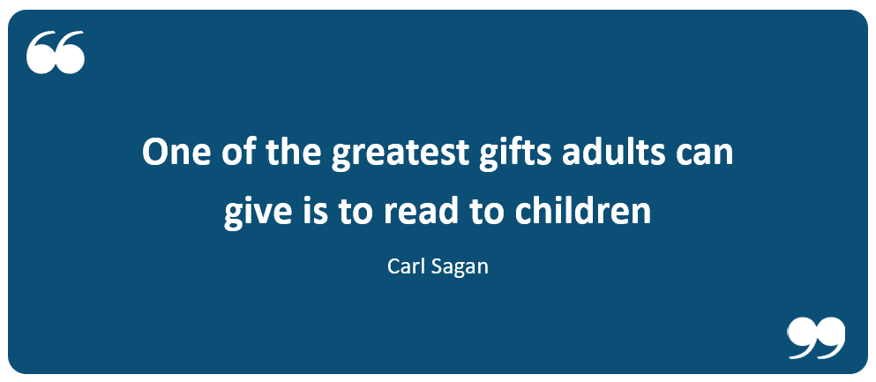
How can you help?

Slide 34
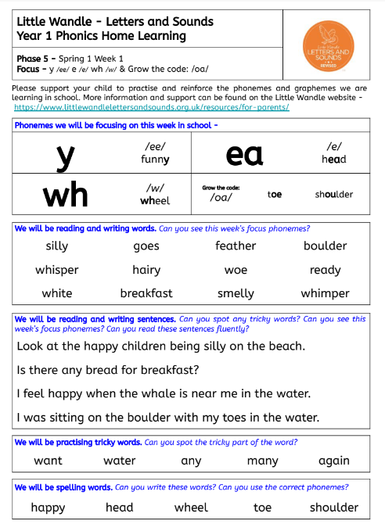
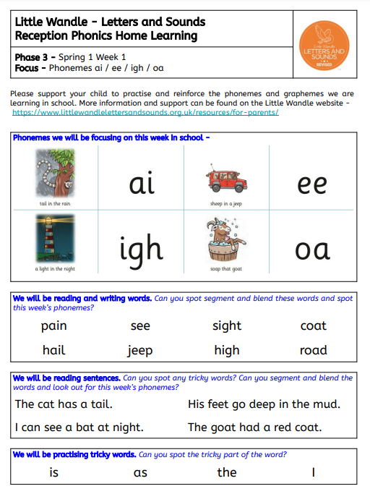
Home phonics folder
Your child will receive a purple phonics folder on Friday.
It will have key phonic information in:
phonics sheet
phoneme pronunciation guide
tricky words
Please bring it every Friday to be updated!
Review with your child the sounds they’ve learnt that week,
read words, read some sentences to develop fluency and
practise those tricky words!

Slide 35
How you can help
Become familiar with the Little Wandle Website and look at the videos and guidance for parents
Ensure you enunciate the sounds correctly ….watch the videos on the website
Let your child ‘show off’ their reading to you and celebrate and praise
Read their ‘decodable’ book as often as you can over the 4 days you have it.
Share books with your children for pleasure
Ensure they bring their reading folder to school daily-but especially FRIDAY!!!!
Go through the phonics sheet at home with them on a regular basis
https://www.littlewandlelettersandsounds.org.uk/resources/for-parents/

Slide 36
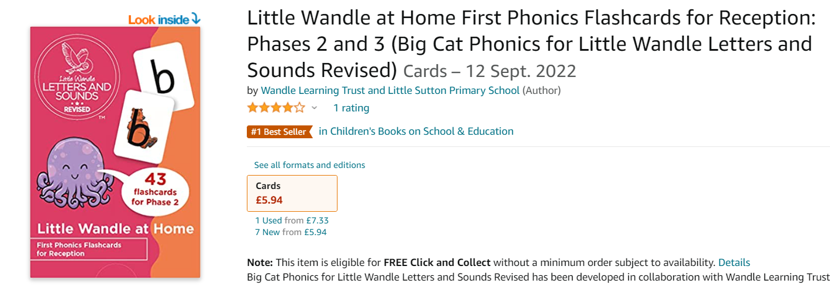
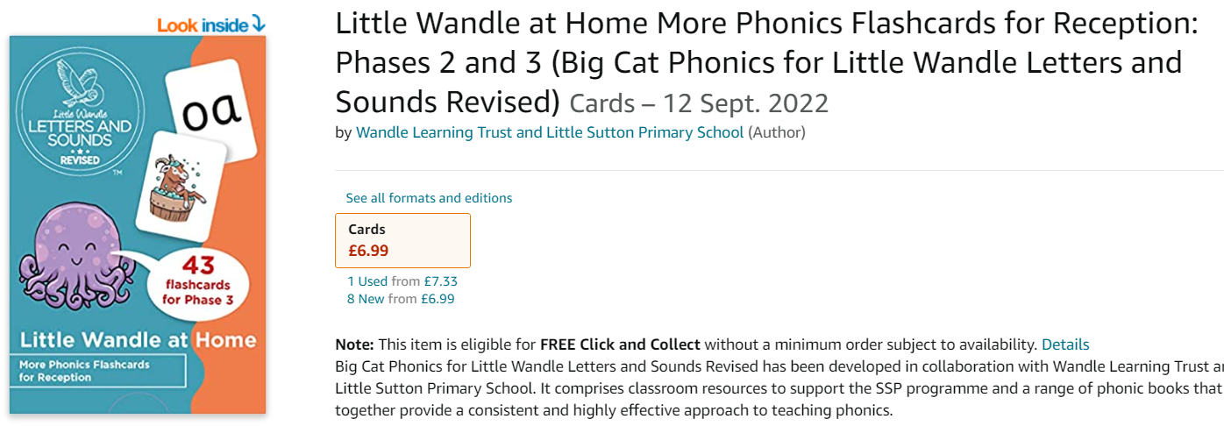
Little Wandle Home Resources
Available on amazon.co.uk
EYFS parents buy the pink pack at the moment

Slide 37
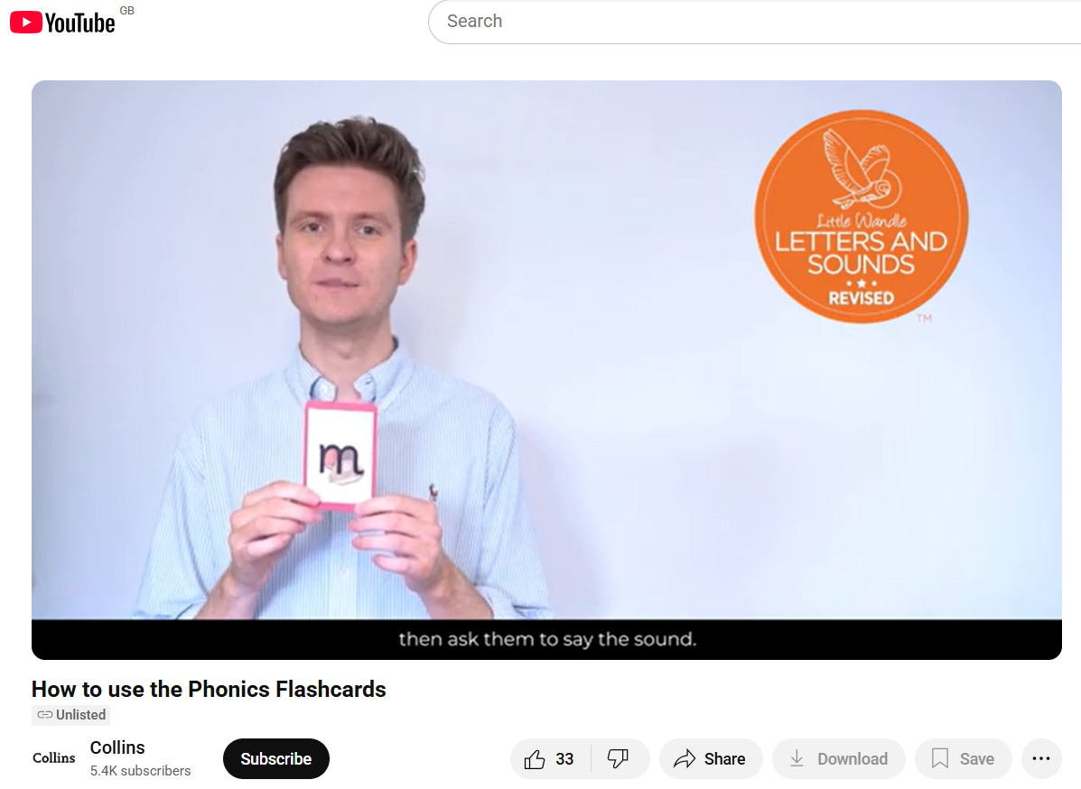
https://www.youtube.com/watch?v=VCCjn0bdoVE

Slide 38
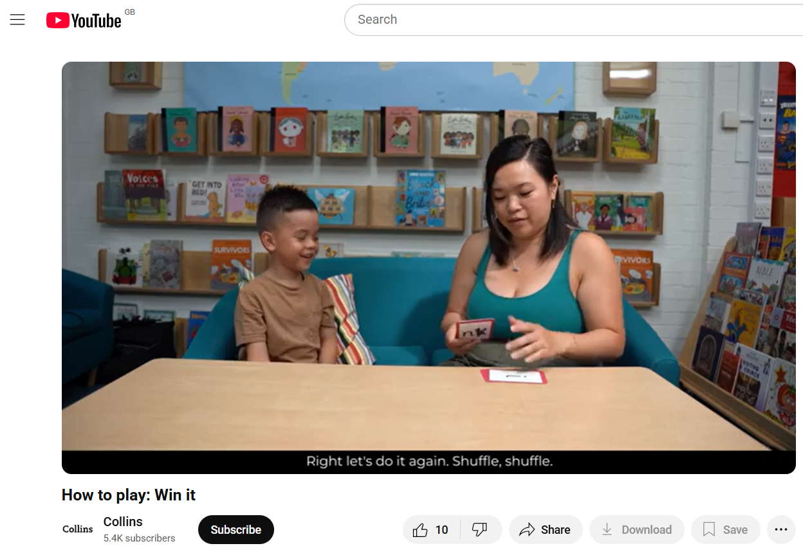
https://www.youtube.com/watch?v=T0rRocdBx2E

Slide 39
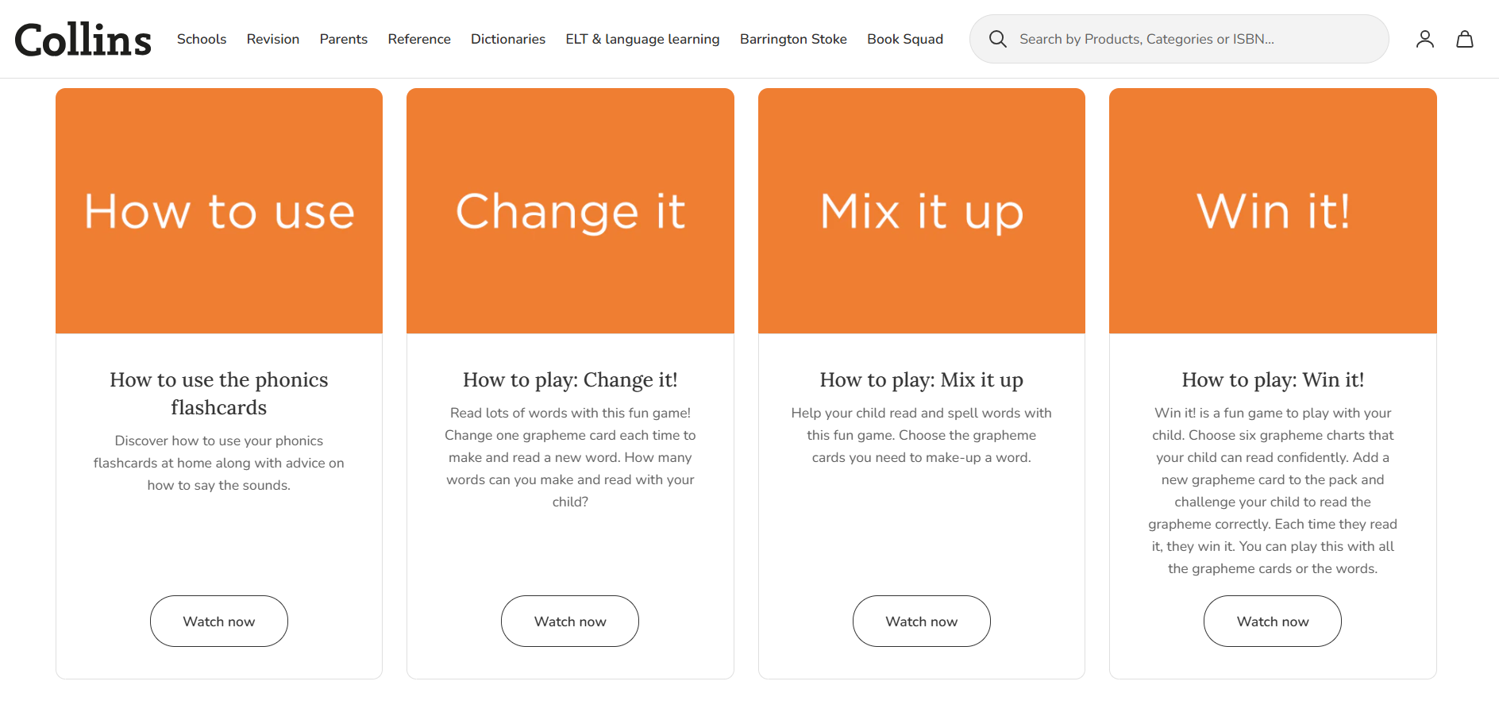
https://collins.co.uk/pages/little-wandle-at-home

Slide 40
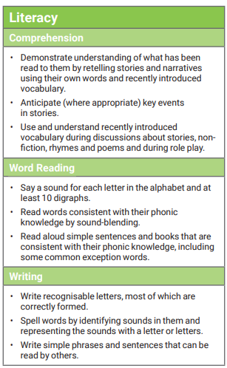
Early Learning Goal

Slide 41
Thank you!!
Thank you for attending!
If you would like anymore information, to discuss anything phonic or reading related or would like support for yourselves or your child, please speak to your child’s class teacher or contact one of us.
Any questions??
cdibden@stm.act-academytrust.org
sowen@stm.act-academytrust.org

